Slide 1

INFINITY MODEL
By - Shreya Pawar FYCS_42

Slide 2
DAY 01
We learnt the simple attributes and structure of HTML:
<!DOCTYPE html>
<html>
<head>
<title> SAKEC </title>
</head>
<body>
<p> welcome in
<br> infinity model in
<br> <b> <strong> department of cyber security </strong> </b>
<br> <i> <ins> Electronics and Telecommunication </ins> </i>
<br> <u> AI & DS </u>
<br> <big> Information Technology </big>
<br> <small> Computer Science </small>
<br> study in class 12<sup>th</sup>
<br> sodium bicarbonate NAHCO<sub>3</sub>
<br> ICSE board,<mark> CBSE board </mark> Maharashtra Board
</p>
</body>
</html>

Slide 3
MAIN CONCEPTS
WE LEARNT THE FOLLOWING ATTRIBUTES ON DAY 1
<h1 style = "color:blue;"> - this gives a h1 heading with blue color.
<p style = "color:red;"> - this gives a red paragraph.
<mark> - this gives a highlighted text.
<sub> - this displays text as subscript.
<sup> - this displays text as superscript.
<b> <strong> - this gives a bold text.
<i> <ins> - this displays text in italics.
<u> - this displays text in underline.
<br> - tag is used to insert a line break within a block of text.
<ul> - tag is used for unordered list.
<ol> - tag is used for ordered list.
<img> - tag is used to insert an image.
<a href> - tag specifies the URL of the page the link goes to.
And the most important thing: the audience won’t miss the point of your presentation

Slide 4
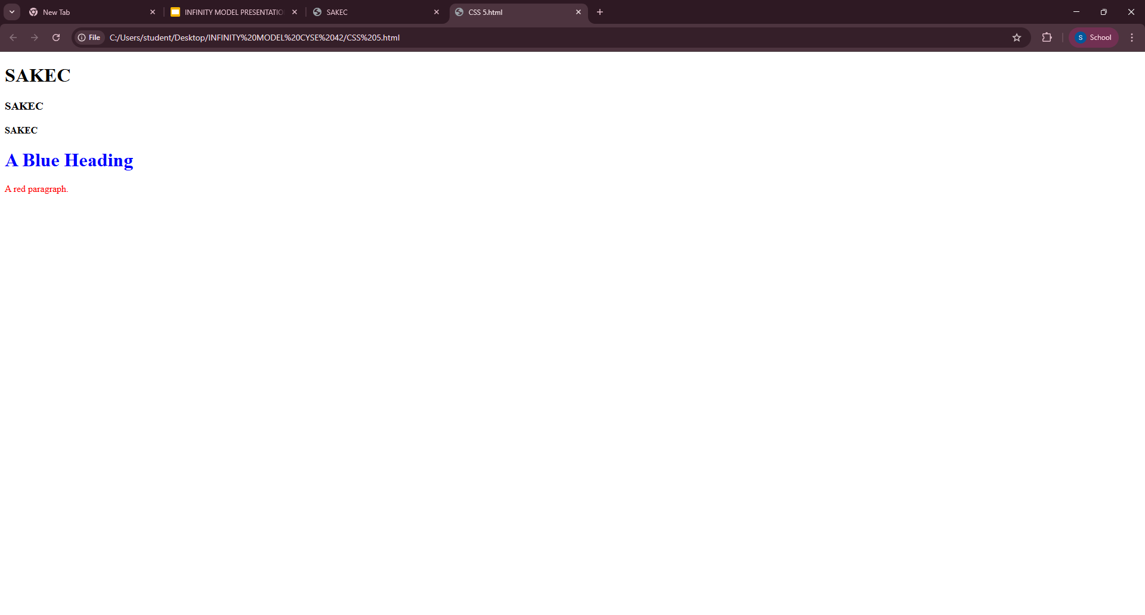
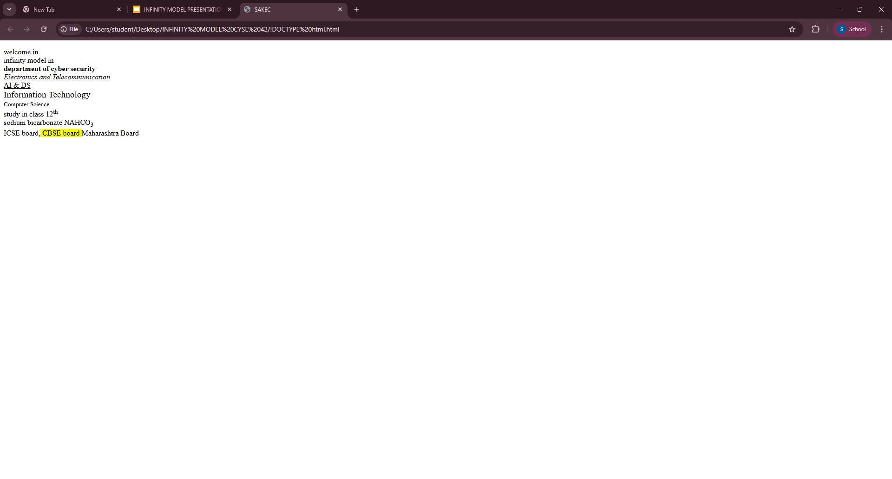
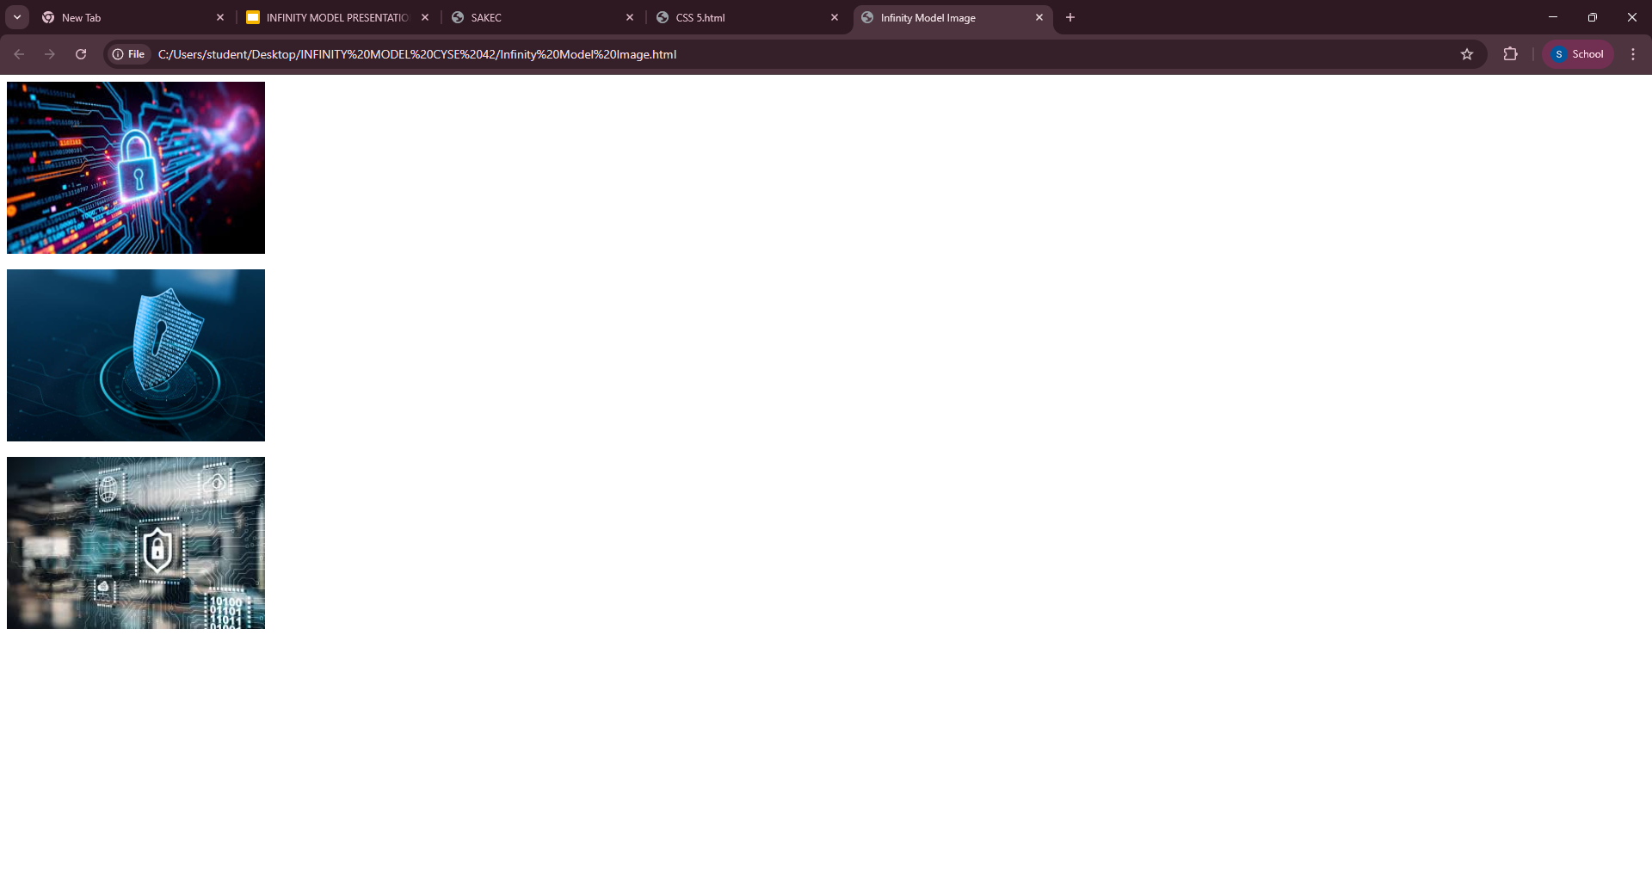
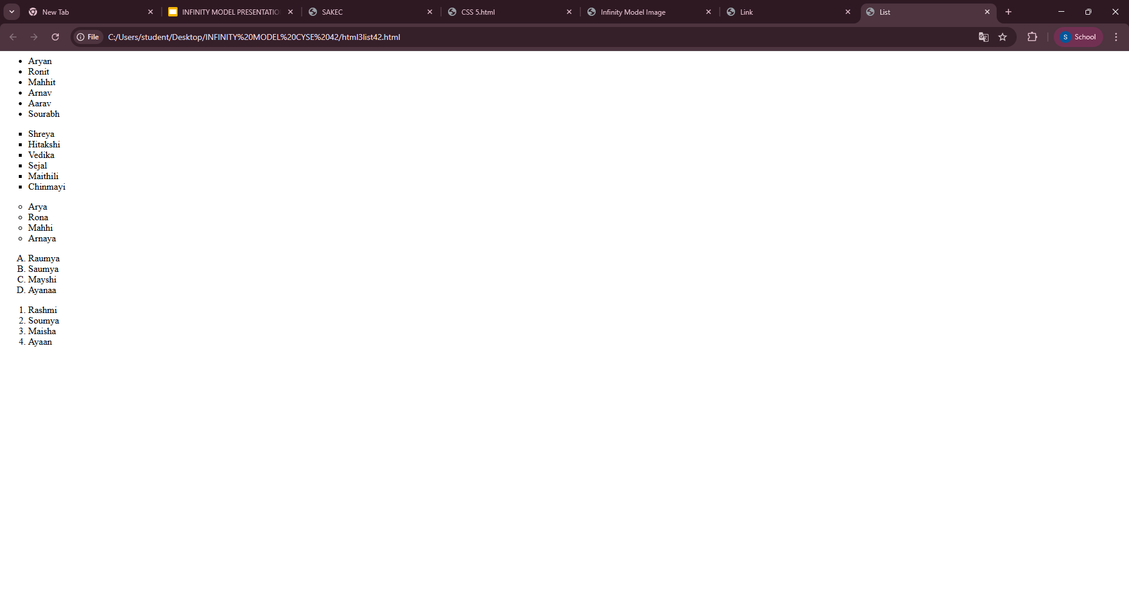
EXPERIMENTS

Slide 5
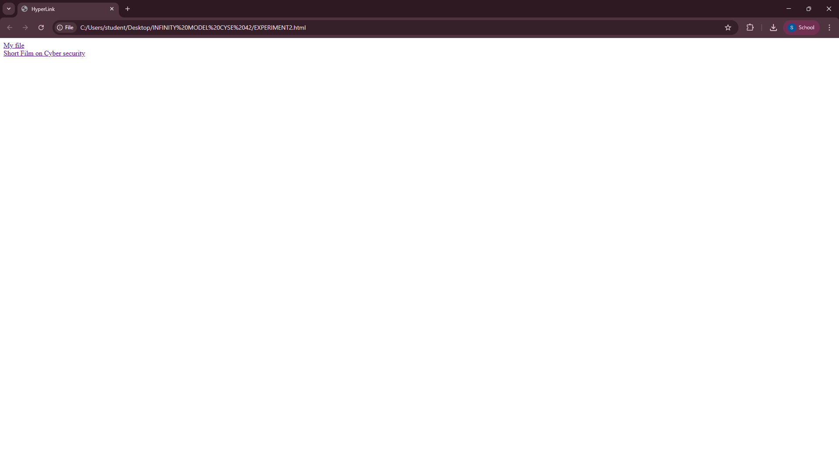
EXPERIMENTS

Slide 6
DAY 02
We learnt the FORM in HTML:
<html>
<head>
<title> Form </title>
<head>
<body bgcolor="#ADD8E6">
<form>
<input type="text" name="name"placeholder="enter your name">
<input type="password" name="password"placeholder="enter your password">
<input type="submit"value="sign in">
</form>
</body>
</html>

Slide 7
DAY 02
We learnt the TABLE in HTML:
<html>
<head>
<title> Infinity Model Table </title>
</head>
<body bgcolor="#ADD8E6">
<table border="2" style="width:100%"; text-align:center;border-collapse:collapse;">
<tr style="background-color:pink;">
<th>Name</th>
<th>Father's Name</th>
<th>Result</th>
</tr>
<tr>
<td>Shreya</td>
<td>Ganesh Pawar</td>
<td>Pass</td>
</tr>
<tr>
<td>Rahul</td>
<td>Dinesh Gupta</td>
<td>Fail</td>
</tr>
<tr>
<td>Saiya</td>
<td>Gigdesh Rana</td>
<td>Pass</td>
</tr>
</table>
</body>
</html>

Slide 8
MAIN CONCEPTS
WE LEARNT THE FOLLOWING ATTRIBUTES ON DAY 2 -
<form> - this is used to create an HTML form for user input.
<fieldset> - tag is used to group related elements within a web form.
<legend> - tag is used to define a caption or title for the content within a <fieldset> element.
<input type> - tag is a fundamental element used within forms to collect user input.
<table> - tag is used to create a table, which displays data in a structured format of rows and columns.
<tr> - this is used to define a row within an HTML.
<th> - tag defines a table header cell.
<td> - tag represents a table data cell.
<style> - tag is used to define internal CSS stylesheets
directly within an HTML document.

Slide 9
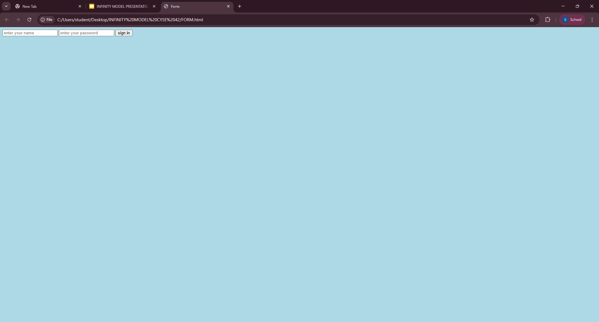
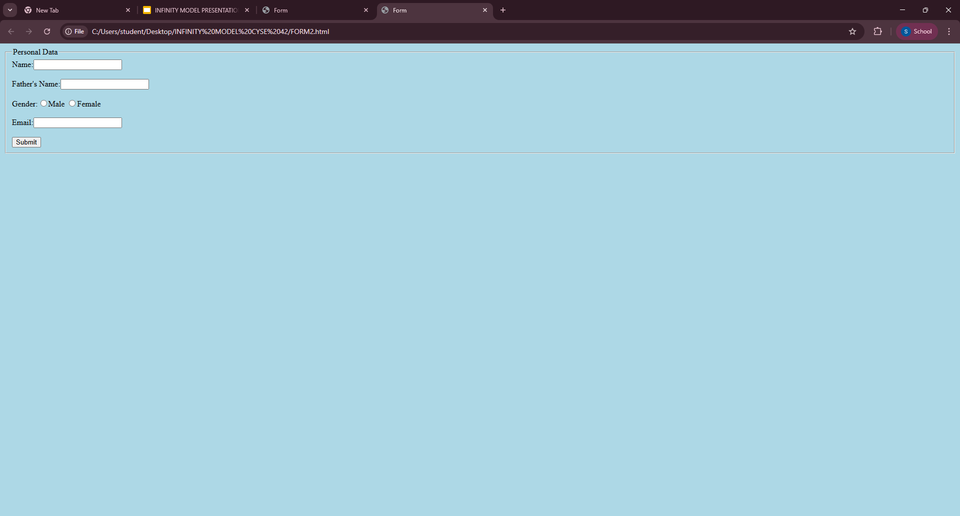
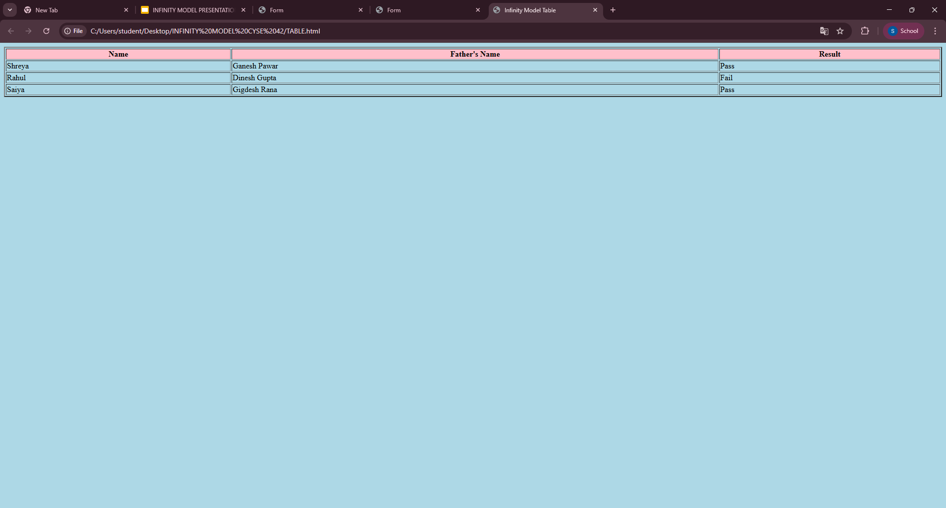
EXPERIMENTS

Slide 10
DAY 03 - PRESENTATION

Slide 11
THANK
YOU

